Slide 1


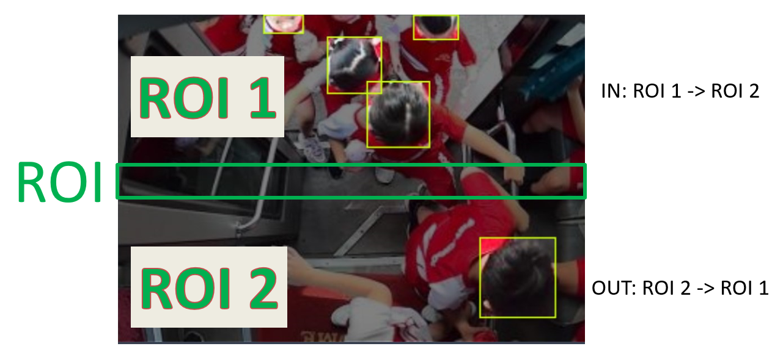
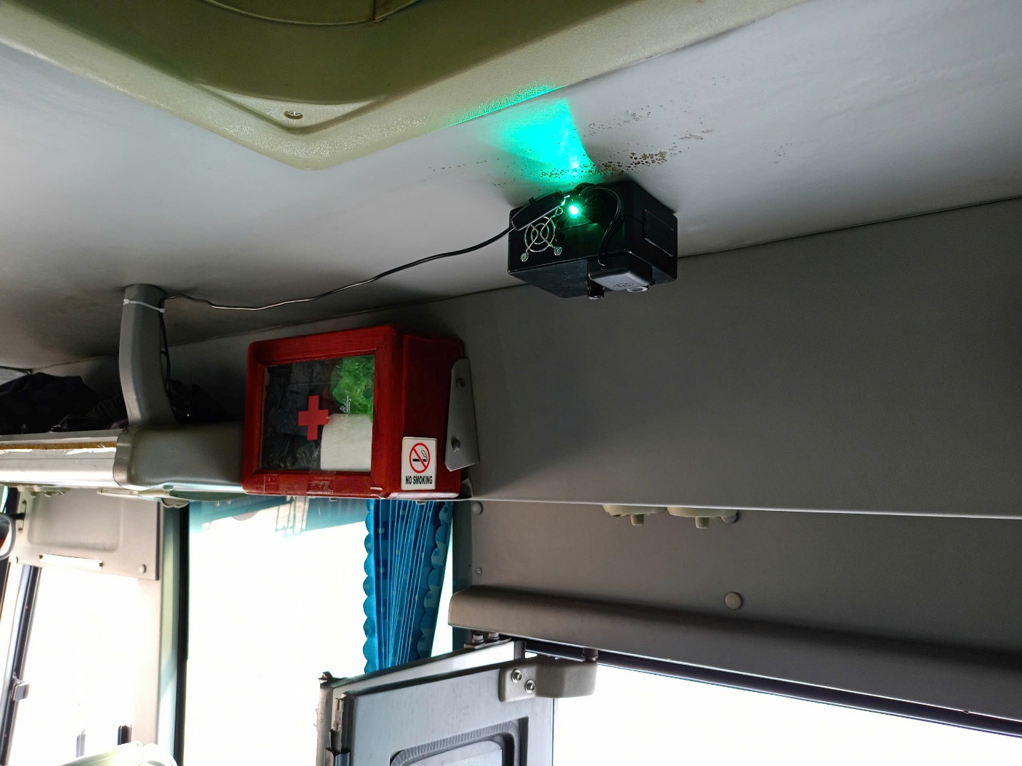
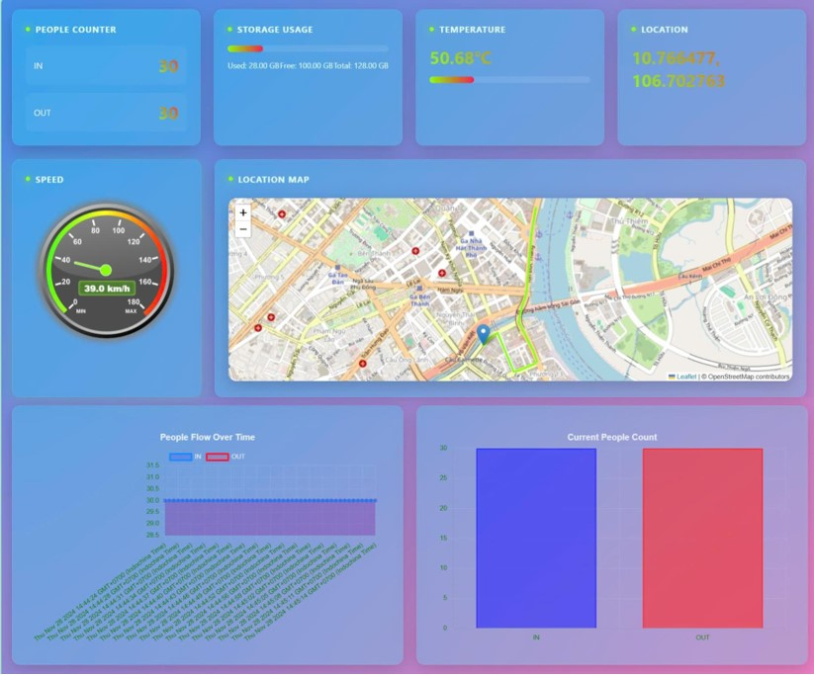
INTELSCHOOLBUS - THE SYSTEM FOR COUNTING
AND CONTROLLING STUDENTS ON SCHOOL BUSES
STUDENT: LE NHAT TAN – ADVISOR: Dr. LE ANH VU
ELECTRONICS - TELECOMMUNICATION ENGINEERING
FACULTY OF ELECTRICAL - ELECTRONICS ENGINEERING, TON DUC THANG UNIVERSITY
OBJECTIVE
INTRODUCTION
Design a low-cost people counting system under $150, compact size (smaller 200x200x100 mm) making it easy to install and deploy on school buses with web monitoring. Operating continuously for 12 hours with a frame rate above 10 FPS.
Developing an affordable AI system to count students and track school buses in real-time with high accuracy. The solution includes hardware, software (website), GPS tracking, and remote monitoring capabilities.
OPERATIONS
Integrating a lightweight, custom AI model for human head detection on RISC-V hardware to count the number of students, while simultaneously collecting GPS data and transmitting all information via MQTT to a Flask-based website displayed these parameters and store the data in SQLite database.
RESULTS
Advantages:
A compact, low-cost solution with optimized AI models for real-time performance.
Intuitive interface, stable operation in real-world environments, efficient IoT connectivity with GPS map integration.
Precise student management, journey tracking, and 12-hour continuous runtime.
Disadvantages:
Power dependency: Potentially limiting long-term autonomous use.
The GPS feature requires a startup time to establish a connection.
CONCLUSION
ACKNOWLEDGMENT
Property | The completed product
Accuracy | 96%
FPS (Frames per Second) | Over 10 FPS
Cost | $108
Weight | 150 grams
Average operating temperature measure | Below 50°C
Operating Time | 12 hours continuously
System Size | 115x90x55 mm
Standards | Industrial-grade wired connection, dustproof, and water-resistant IPX22
I would like to extend my deepest gratitude to Dr. Le Anh Vu, my undergraduate thesis advisor.
REFERENCES
[1] Chang, Y.-W., Pan, J.-W., & Hsu, Y.-W. (2020). Estimation of the number of passengers in a bus using deep learning. In MDPI Sensors (pp. 20-33). Basel, Switzerland: Multidisciplinary Digital Publishing Institute.
[2] Grönman, J., Sillberg, P., Rantanen, P., & Saari, M. (2019). People counting in a public event—Use case: Free-to-ride bus. In Proceedings of the 42nd International Convention on Information and Communication Technology, Electronics and Microelectronics (MIPRO) (pp. 10-19). Rijeka, Croatia: IEEE Press.
UNDERGRADUATE THESIS OF FACULTY OF ELECTRICAL - ELECTRONICS ENGINEERING, TON DUC THANG UNIVERSITY

